Slide 1
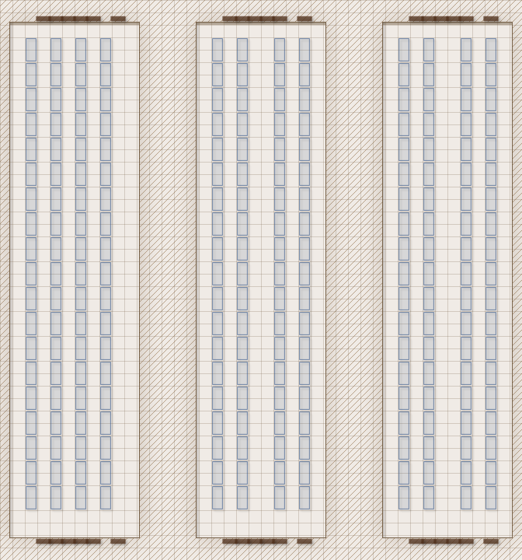
The Plot: An "AI" known only as Star begins to suspect she's actually a human being locked in VR inside a Renraku lab. If she really is, she wants out. The Job: Infiltrate the lab and enable a camera feed. Hold position while Star analyzes the data and provides further instruction. The Pay: 500¥ up front, up to 2500¥ bonus for responding to additional directives onsite.
Scene 1 (Social). Setting: Dante's Inferno. The Hook: Runners were told by their fixers to meet here. Must go to the 2nd floor, table 23. Given dossiers with images, major skills, names of the rest of the team (have players introduce their characters). Events: Influence + CHA (3) – staff direct the player to the table where Mr. Johnson awaits. Mr. Johnson introduces Star as the client's representative. Influence + INT (7) – players figure out Star is the client. Negotiation: per SMG p16, vs Influence 5 CHA 6, 5% increase/decrease in base pay per hit (max still 3k per SMG).
Scene 2 (Investigation). Setting: per players. Available Info:
The lab is on a deserted island in Outremer. The area is infamous for MCT "Zero Zones“ (any infiltrator is hunted by a HTR team until confirmed eliminated).
The Renraku lab is on a small island in Puget sound.
The lab has an underwater hardline that runs under the city directly to the Renraku Arcology. Lab host is behind the main Renraku host (Rating 9+). Cameras can be redirected locally.
The island has basic watcher spirits and wards, but local magical security presence is otherwise light.
The island uses reverse osmosis for water and receives shipments of food and supplies daily. The players can bribe a grocer to include them in the next shipment.
Staff on the island rotate on a shifting weekly basis.
Optional Rules for Initiative. Purpose: Get all players involved in all scenes at First Taste. Social: Influence + CHA. # hits determines order. Ties: Edge, CHA, INT, Coin Flip. Investigation: Perception + INT. # hits determines order. Ties: Edge, INT, REA, Coin Flip.
Scene 3 (Investigation). Setting: The deserted island. Edge: 1 per 2 successes in Scene 2 for each player (max 2). Challenges:
Guards at the dock are Renraku Patrolmen (stats: CRB 206). Routine shipments are scanned by a Doberman with a chemsniffer (rating 3, CRB 242).
Area around the warehouse is patrolled by fly spies, rating 1 watcher spirits, and rare patrols.
There are three warehouses (see map). Cameras are on each of the exterior and interior corners.
Camera feeds will need to be handled or Renraku will know the feeds are gone.
With cameras, PCs will see rows of metal boxes, each 1x1x2m. Each is connected by a large bundle of cables that pierces the floor of the warehouse.
Star orders the players to retrieve unit 2-037 (2nd bldg.). To leave the unit with a courier who will meet them anywhere on the mainland. Tells the runners to prepare for a fight once they enter the building. She then disconnects (she will be unconscious during transport).
Scene 4 (Combat). Setting: The highway ambush. Edge: 1 per 2 successes in Scene 3 for each player (max 2). Challenges: 1 enemy per player (max 4). Choose from:
Patrolman (CRB 206)
Decker (CRB 205)
Combat Mage (CRB 206)
SWAT Officer (CRB 206)
Electronics (Hardware, 7, 1 Major Action) Extended Test to disconnect the machine. The entire unit is 400kg. Players will need to figure out a way to get the unit off the island.
Miss Taken Entity
A Shadowrun 6e First Taste by Zeshan Rajput
https://creativecommons.org/licenses/by-sa/3.0/
CRB: Shadowrun 6th Edition Core Rule Book
SMG: Shadowrun Missions Guide v1.6
Map Credit: Personal creation
Picking Up the Pieces. Pay: negotiated base pay +
500¥ for getting the camera feed
1000¥ for securing the machine
1000¥ for getting the machine back to the courier
Max 3k per player
Karma: 3 karma for adventure survival.
Contacts: Yuriko Star (Corporations – Renraku, Data Havens, Connections 2 Rating 1). A technomancer that Renraku held since birth and made believe she was an AI.

